Slide 1
Precise Semantics of
UML State Machines
(PSSM)
RFP ad/2015-03-02
Initial Submission ad/2016-02-01
(Revision ad/2016-03-01)
Presentation to the ADTF
16 March 2016
Ed Seidewitz / Model Driven Solutions
Jérémie Tatibouet / CEA

Slide 2
Submission Team
Submitters
BAE Systems (Jeffrey Smith)
Model Driven Solutions (Ed Seidewitz)
No Magic, Inc. (Nerijus Jankevicius)
Contributors
Airbus (Yves Bernard)
Simula Research Laboratory (Bran Selic)
LieberLieber (Daniel Siegl)
CEA – Commissariat à l’Energie Atomique (Jérémie Tatibouet)

Slide 3


Mandatory Requirements
Requirement | Response
6.5.1a Behavior state machine semantics (excluding redefinition and submachines) | All required elements, except: Junction and history pseudostates Triggers with call events
6.5.1b Event data passing | Approach under discussion, not yet incorporated into execution model.
6.5.1c Standalone and classifier behavior execution | Proposal is restricted to these two cases.
6.5.1d Consistency with PSCS | Achieved by defining PSSM execution model as an extension of the PSCS model.
6.5.1e Relationship to fUML | Achieved by defining PSSM execution model as an extension of the fUML model.
6.5.1f Extension of fUML base semantics (if necessary) | This was not found to be necessary.

Slide 4
Mandatory Requirements
Requirement | Response
6.5.2a Semantic variabilities | Proposal does not define any additional semantic variabilities.
6.5.2b Semantic variants | Proposal does not define any additional semantic variants.
6.5.3a UML 2 conformance | Proposed PSSM syntax subsets UML 2.5 abstract syntax.
6.5.3b fUML conformance | Proposed PSSM semantics are based on fUML 1.2.1.
6.5.3c PSCS conformance | Proposed PSSM semantics are based on PSCS 1.0.
6.5.3d Common Logic conformance | Not applicable, proposal does not extend the fUML base semantics.
6.5.4a Test suite | Proposal includes suite of 64 tests.
6.5.4b Test suite coverage | Current coverage is about 81% of identified functional requirements.

Slide 5
Non-Mandatory Features
Feature | Response
6.6.1 Submachine states | Not included in the proposal.
6.6.2 Protocol state machine | Proposal includes a non-normative annex on protocol state machines.
6.6.3 State machine redefinition | Proposal discusses the semantics of state machine redefinition, but it is not yet included in the formal execution model.
6.6.4 Asynchronous operation calls | Not included in the proposal.
6.6.5 Triggers with ChangeEvents | Not included in the proposal.
6.6.6 Alf for action language concrete syntax | Proposal uses Java as the action language. (Alf may be used in the future.)

Slide 6
Issues To Be Discussed
State machines for passive classes
  Supported in several UML tools.
  Semantics are not entirely consistent with active behavior machine semantics.
  Discussed in informative annex in proposal.
Abstract syntax issues with passing event data
  Event data passing to/from effect, entry, exit and do behaviors without changing UML abstract syntax.
  Event data passing to transition guards may required an abstract syntax change.
Relationship to MARTE causality model
  MARTE causality model based on UML 2.1 semantics.
  Still seems generally consistent with UML 2.5 common behavior semantics.

Slide 7
Issues To Be Discussed
Relationship to OntoIOP
  Not yet addressed.
Relationship to SCXML
  SCXML has a significant overlap with UML state machines, but there are differences.
  Possible to define a mapping from a subset of UML state machine syntax to SCXML with consistent semantics.
  Plan to provide such a mapping in the revised specification.
Proof of concept implementation
  Developed by CEA .
  Integrated into the Eclipse Papyrus/Moka model execution framework, built on PSCS/fUML implementation.
  Passes all 64 current PSSM tests, without violating any PSCS tests.

Slide 8
Conformance
Level Aspect | PSSM only | PSSM and PSCS
Syntax | PSSM abstract syntax is a superset of fUML abstract syntax PSSM abstract does not include PSCS abstract syntax | Union of PSSM abstract syntax and PSCS abstract syntax
Semantics | Execution tool must provide semantics consistent with PSSM execution model. Semantic conformance with fUML All PSSM tests pass except those related to triggers with ports references. | Execution tool must provide semantics consistent with PSSM and PSCS execution models. Semantic conformance with fUML All PSSM tests pass All PSCS tests pass

Slide 9


Submission Structure
PSSM test suite models conform to the PSSM syntax
Requirements
PSSM Syntax
PSSM Test suite
PSSM Semantic models captures semantics of PSSM syntax
Test execution enables semantic definition validation
Implementation is used to execute the test models defined within the test suite
Implementation
PSSM Semantic
PSSM semantics in Papyrus Moka model execution tool

Slide 10
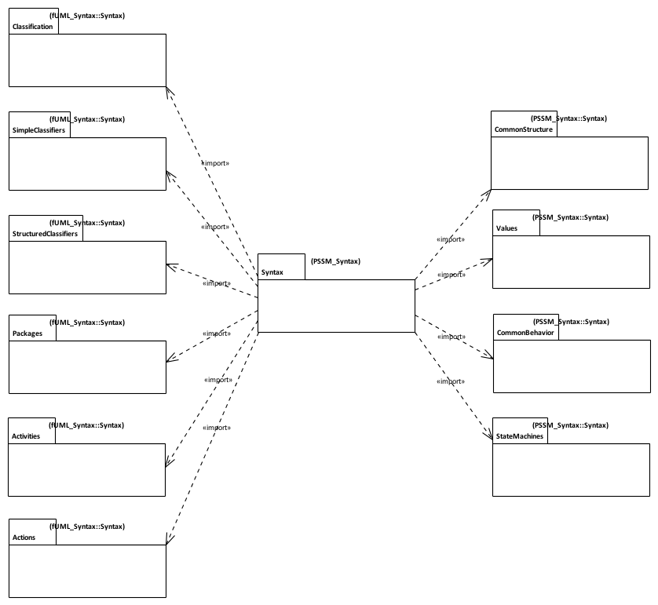
PSSM Syntax
Issue
fUML 1.2.1 abstract syntax is currently organized according to UML 2.4.1, not UML 2.5.
Syntax imported from fUML with additions
PSSM Syntax is a superset of fUML syntax
Additional Syntax for State Machines
Syntax imported without change from fUML.

Slide 11
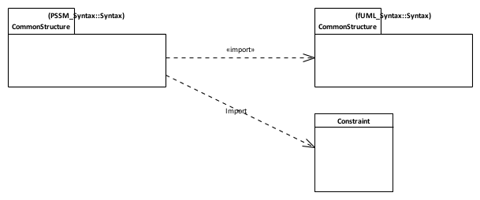
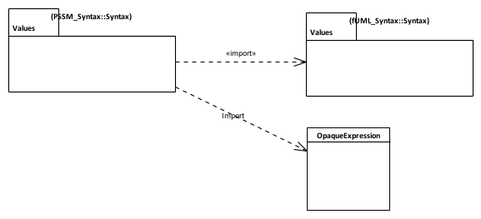

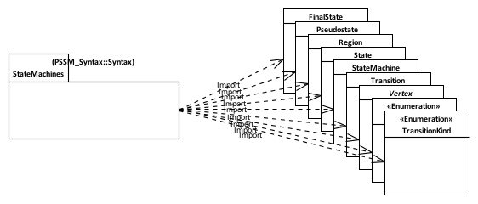
PSSM Syntax: Subsetting
Constraint can have a specification given as a an OpaqueExpression which can be associated to a Behavior
Guards placed on transitions are defined as Contraints
A transition can be associated with 0..* triggers. One of the Triggers can be for a CallEvent.
Behavior state machine syntax elements

Slide 12
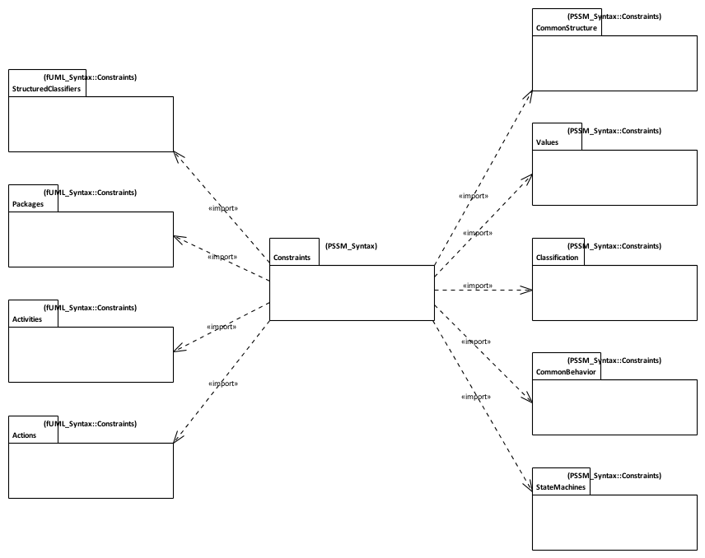
PSSM Syntax: Constraints
Constraints imported from fUML with additions / changes
Constraints imported without change from fUML.
Additional Syntax for State Machines

Slide 13
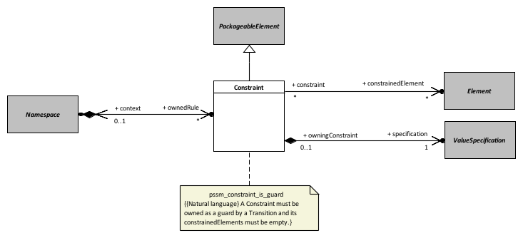
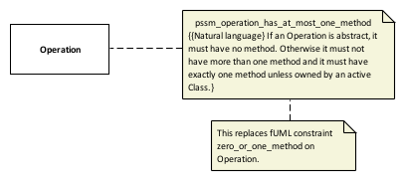
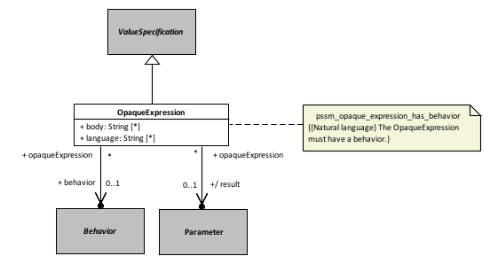
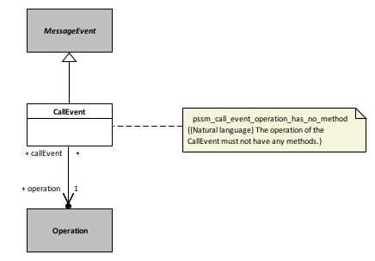
Constraints: Additions and Updates
Common Structure
Classification
Values
Common Behavior
Issue
Constraints are owned by the PSSM Values constraints package, not by the constrained elements. What is the OCL context?

Slide 14
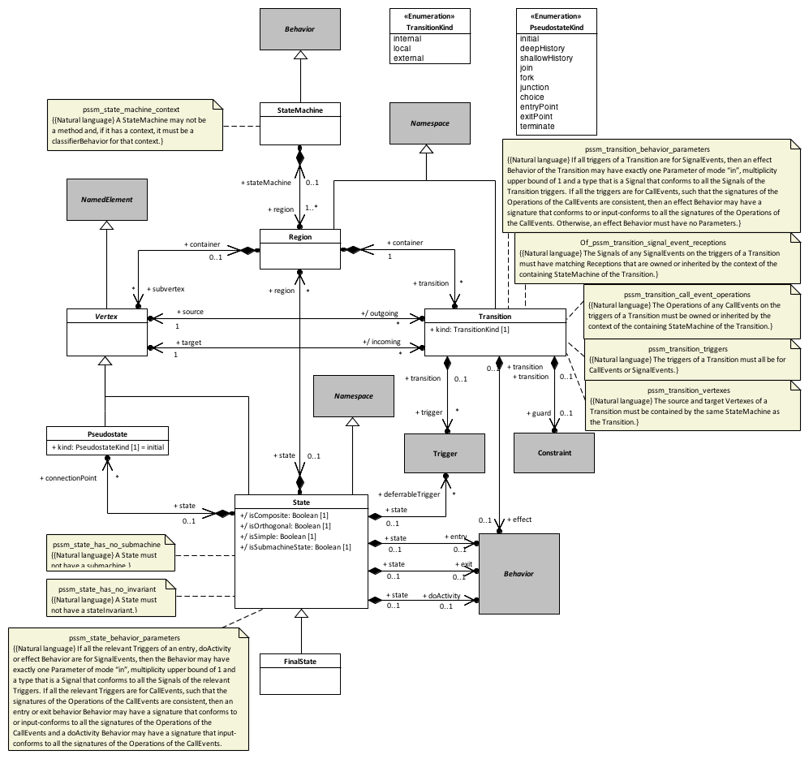
Constraints: Behavior State Machines

Slide 15
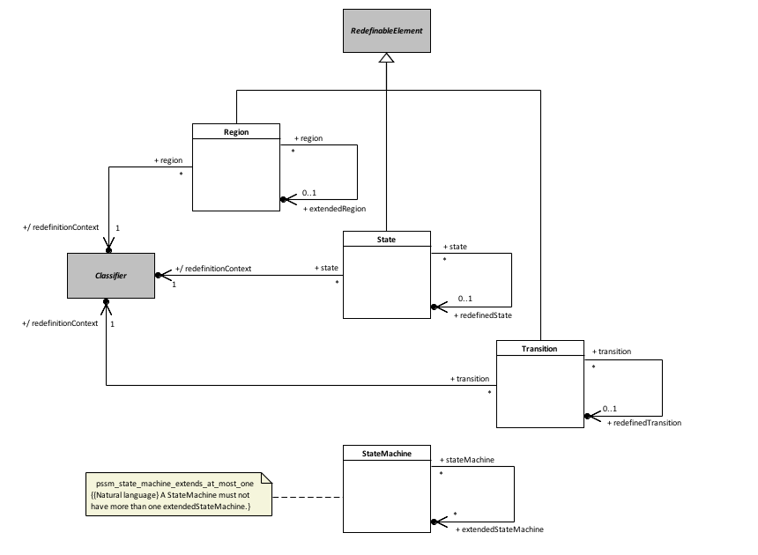
Constraints: State Machine Redefinition
Issue
When a Transition is redefined, its source and target must also be redefined. These may be Pseudostates, but Pseudostates are not currently redefinable.
Possible Solution
Make Vertex superclass of State and Pseudostate a RedefinableElement).

Slide 16
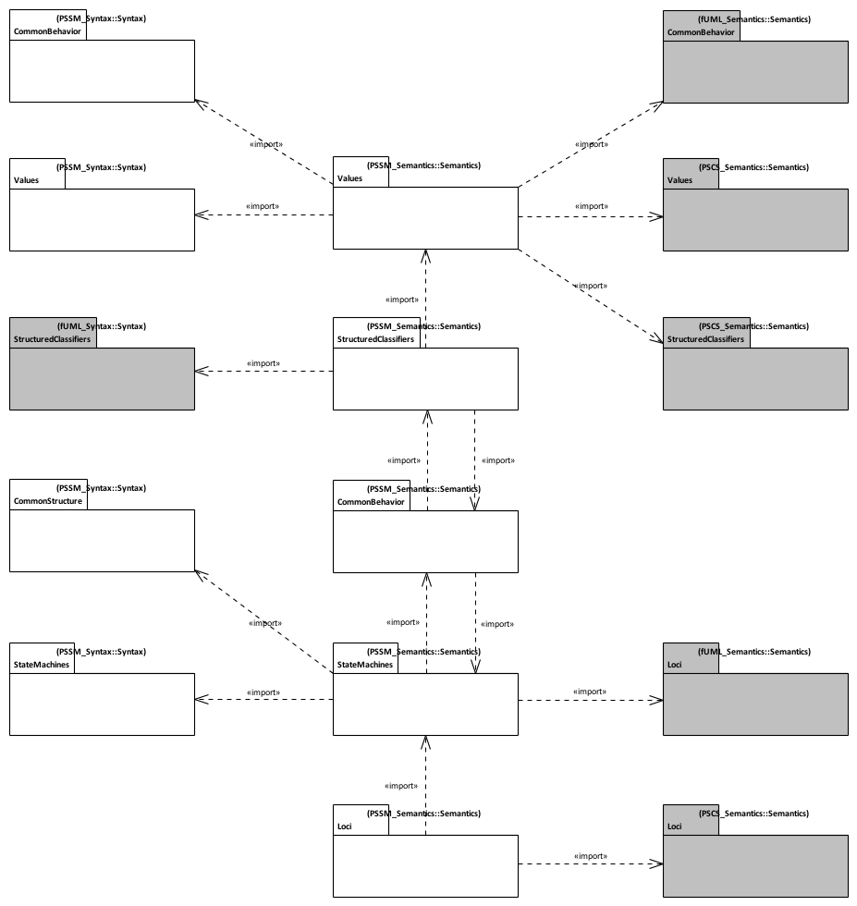
PSSM Semantics
PSSM syntax packages
fUML and PSCS semantics packages
Issue
fUML 1.2.1 and PSCS 1.0 execution models are currently not organized around UML 2.5.
PSSM semantics packages
Notes:
Alignment with UML 2.5 - PSSM semantic model is aligned with UML 2.5 package structure
PSSM Semantic model layout
Values - Semantic model elements extending fUML and PSCS semantics for values.
StructuredClassifiers - Semantic model elements extending fUML and PSCS semantics for structured classifiers.
Common behavior - Semantic model elements extending common behavior semantics for UML state-machines specific needs.
StateMachines - Semantic visitors capturing semantics of behavior state-machines meta-classes.
Loci - Semantic model elements extending fUML and PSCS semantics for instantiation.

Slide 17
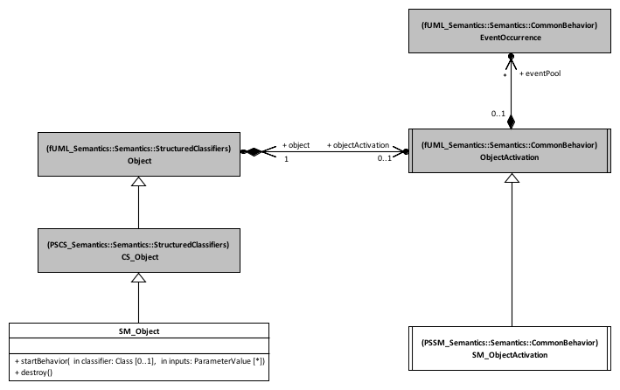
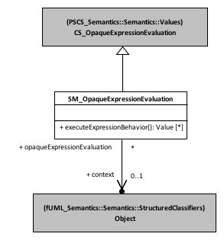
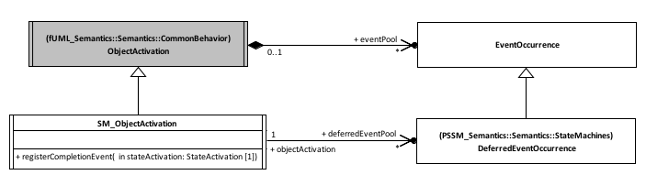
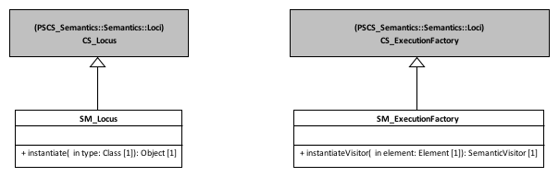
PSSM Semantics: Extensions to PSCS
Structured Classifiers
Values
The evaluation has access to the context object. This enables the opaque expression to access features (e.g. attributes) values available at the context object.
startBehavior instantiates a SM_ObjectActivation.
destroy also clears the event pool.
Common Behavior
Loci
Registers completion events in the event pool.
Specific pool for deferred event occurrences.
Always instantiates a Class as an SM_Object.
Instantiates visitors for state machine elements.
Notes:
Structured Classifiers
(none)
Values
Transition guards are Constraint
Constraint can have a specification which is a ValueSpecification
An OpaqueExpression is a kind of ValueSpecification which can be associated to a Behavior.
Common Behavior
Allow registration of completion events
Generated when a state completes
Allow handling of deferred events
Deferred events are event occurrences whose dispatching needs to be deferred in the current state-machine configuration.
Loci
(none)

Slide 18
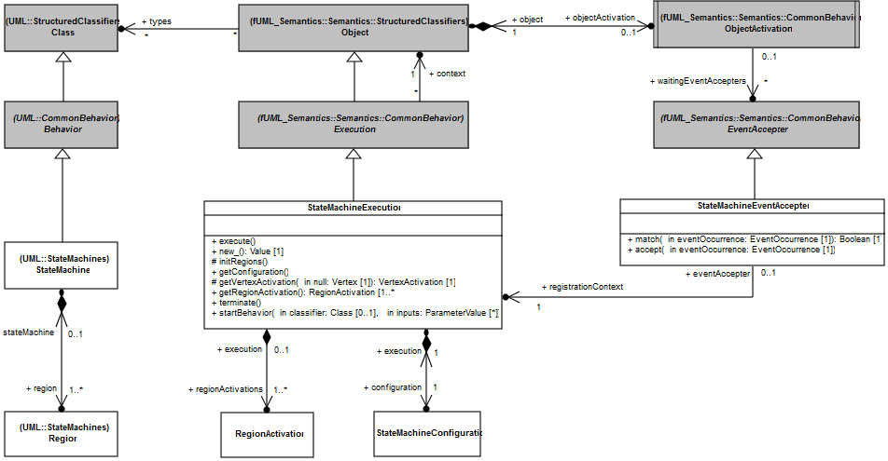
Semantics: State Machine Execution
State-machine specific event accepter. There is only one per state-machine execution. The matching of an event occurrences is decided by the analysis of the state-machine configuration.
Represents the execution of a particular state-machine. It contains region activations which themselves contains semantic visitors for each syntactic elements contained in the visited regions.
Hierarchy of active states that the state-machine execution is in

Slide 19
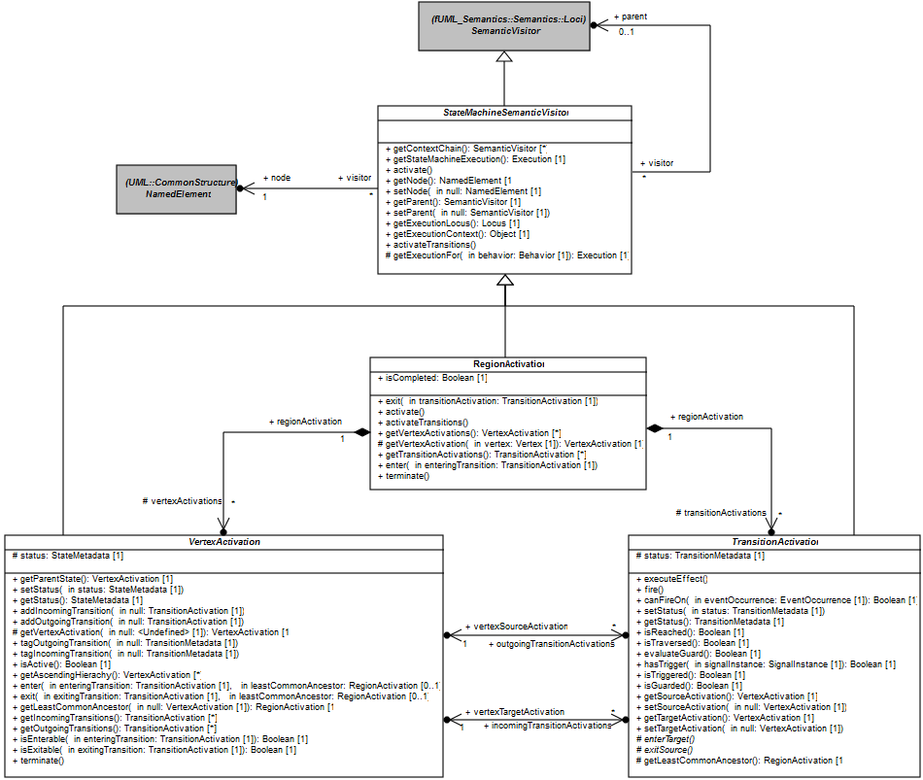
Semantics: State Machine Visitors
StateMachineSemanticVisitor is associated to StateMachine element
StateMachineSemanticVisitor are organized as a tree.
StateMachineSemanticVisitor is an fUML SemanticVisitor for an element within a StateMachine. It provides utility operations that are inherited by specialized StateMachineSemanticVisitor.
RegionActivation captures Region semantics. It contains both VertexActivation and TransitionActivation
VertexActivation captures the base semantics for all kind of vertices.
TransitionActivation captures base semantics for the different kinds of Transition
All VertexActivation entered and exited using enter/exit operations. These operations are specialized in specialized type of vertices
Firing a transition always consists in exiting the source, executing the effect (if any) and entering the target. The way the source is exited and the target is entered is specific to the different kind of transition.

Slide 20
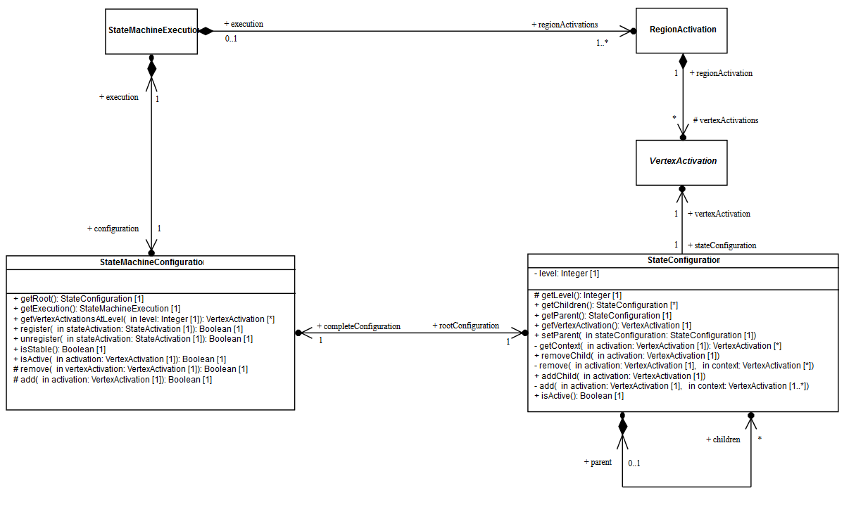
Semantics: State Machine Configuration
A StateMachine Configuration represents the hierarchy of activate states the currently executed state-machine is in.
Internal structure of a configuration is given as a hierarchy of StateConfiguration. Each StateConfiguration in the hierarchy designate a currently active state.
A StateMachineConfiguration always belongs to a StateMachineExecution
Notes:
Rationale
State machine configuration evolves only
In a run-to-completion step
When a state is entered
When a state is exited
It does not evolve between two run-to-completion steps
It is used to assess if a state-machine is ready to accept a dispatched event occurrence

Slide 21
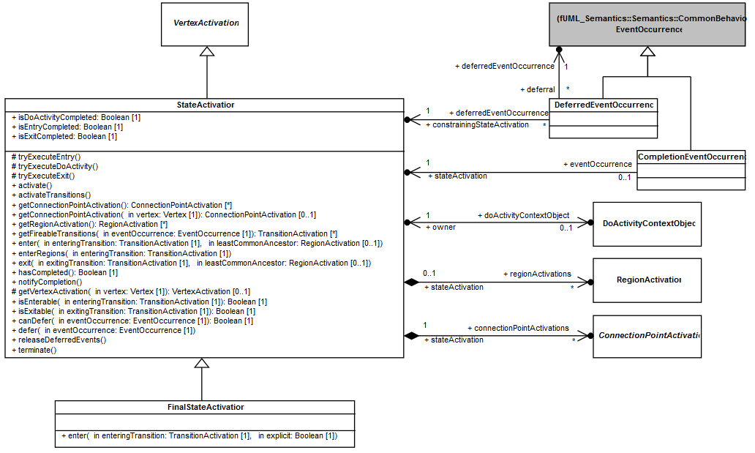
Semantics: State Activation
A StateActivation can defer an EventOccurrence. This latter is wrapped into a DeferredEventOccurrence. Such occurrence is registered in the deferred event pool
StateActivation captures semantics of a State (simple or composite)
Boolean flags indicate if the state is ready to complete
When a StateActivation is ready to complete, it generates and registers a CompletionEventOccurrence in the event pool
FinalStateActivation captures semantics of a FinalState.
The DoActivityContextObject related to a StateActivation materializes a possibly running doActivity behavior.

Slide 22
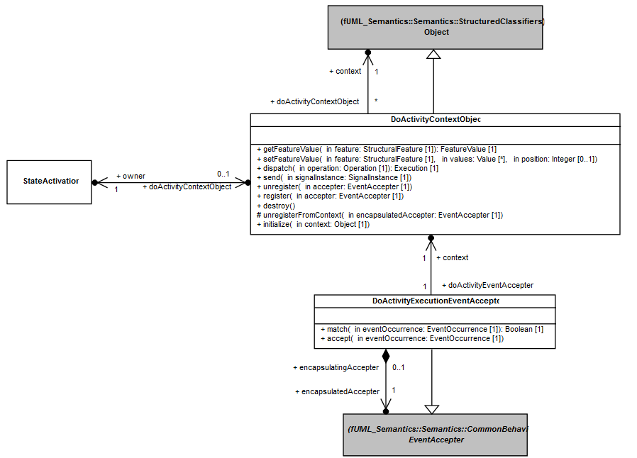
Semantics: Do Activity Execution
The context of a DoActivityContextObject is the context of the state-machine from which the doActivity was invoked
DoActivityContextObject defines the place at which a doActivity behavior is executed. It has an object activation, and so the doActivity evolves on its own thread of execution
If a StateActivation has invoked a doActivity behavior that is currently running, then it has an associated DoActivityContextObject
  If accepters are registered by the doActivity, then they are also registered at the state-machine context object activation. A doActivity is completed if no more event accepters are registered with the object activation of its context object.

Slide 23
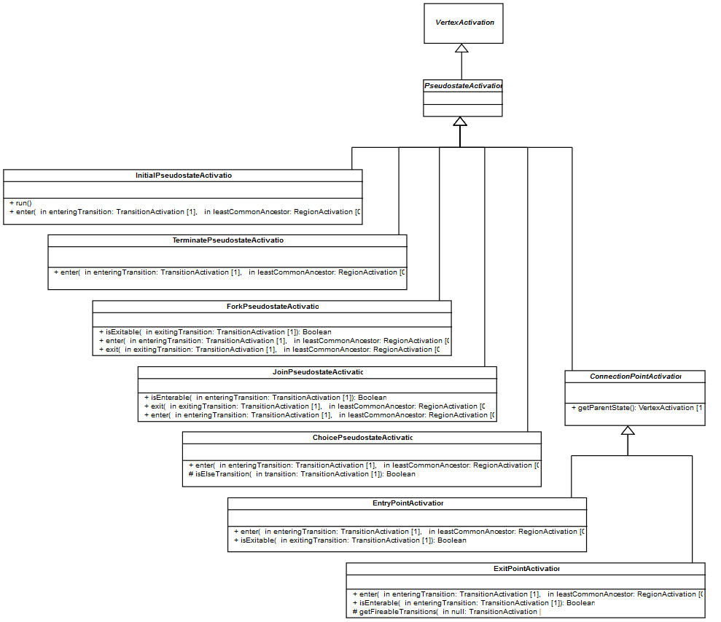
Semantics: Pseudostate Activations
Each specialization of PseudotateActivation captures semantics of a Pseudostate, by redefining the enter and exit operations and defining constraints (if required) to enter and exit a pseudostate.

Slide 24
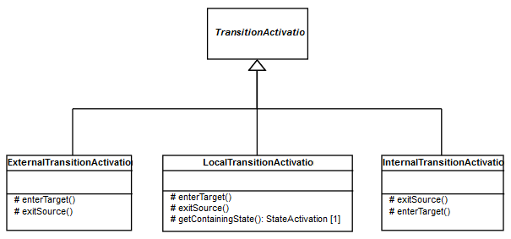
Semantics: Transition Activations
Each specialization of TransitionActivation captures semantics of a kind of Transition, by redefining the exitSource and enterTarget operations.
For InternalTransitionActivation, the source is never exited and the target is never entered.

Slide 25
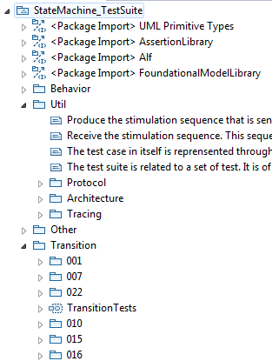
Test Suite
Util package
  Defines how a semantic test is designed
  Defines how semantic tests are grouped into semantic test suites
  Defines how elements composing a test interact
Other packages
  Define test categories
  Each category is related to particular part of state-machine semantics
  Each category contains test cases
  Each test case is defined to validate a specific semantic requirement
Library providing base elements to define semantic tests
Test category related to transition semantics
Semantic tests available in that category

Slide 26
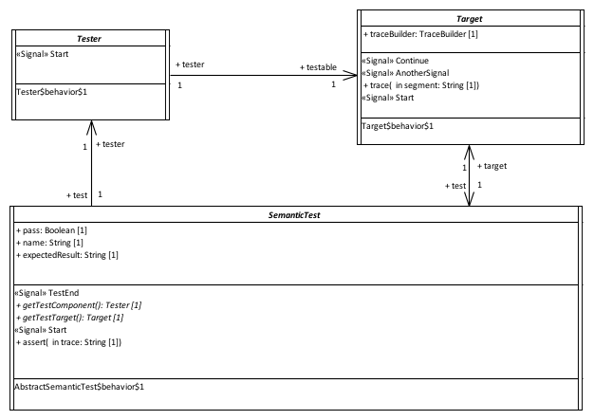

Test Suite: Semantic Test Architecture
Communications done by signal passing
Provide a stimulation sequence (i.e., a set of event occurrences) to the Target.
Execute the state-machine under test and record the execution trace produce by this state-machine
The SemanticTest controls both the Tester and the Target. It is also responsible for the computation of the test verdict. The test verdict calculation is based on the comparison between the generated execution trace and the execution trace expected by the test.

Slide 27
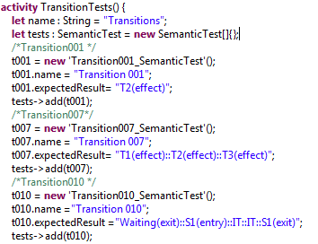
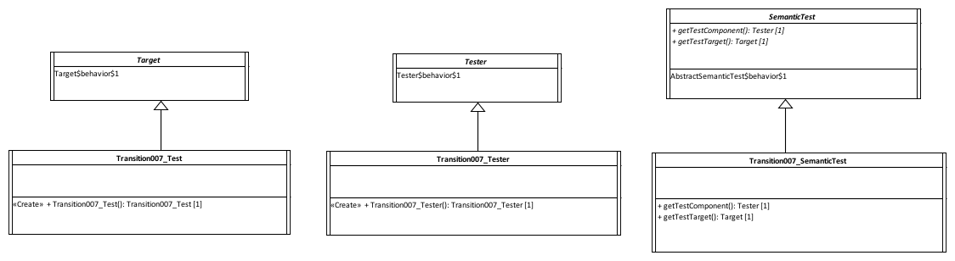
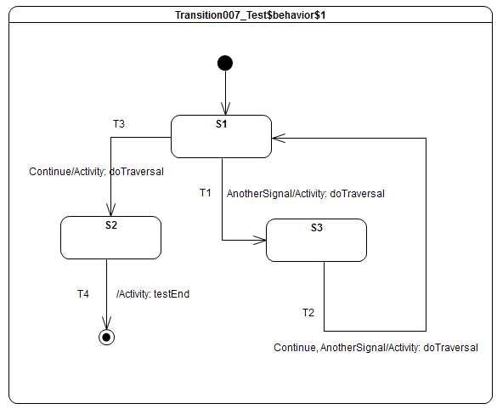
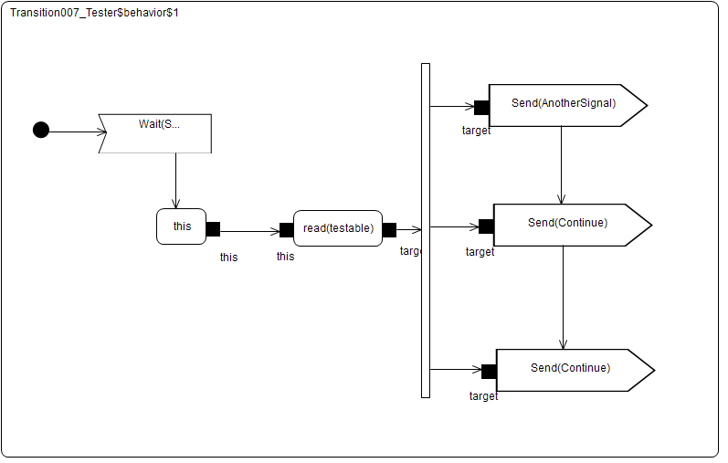
Test Suite: Example Test Definition
Semantic test is instantiated and registered in a semantic test suite.
Expected execution trace

Slide 28
Test Suite: Example Test Execution
Received event occurrences
AnotherSignal – S1
Continue – S3
Continue – S1
Expected trace
T1(effect)::T2(effect)::T3(effect)
Requirement
A transition may own a set of Triggers, each of which specifies an Event whose occurrence, when dispatched, may trigger traversal of a transition.
Step | Event Pool | Configuration | Fired transitions
1 | [] | [] – Initial RTC step | [InitialTransition]
2 | [AnotherSignal, CE(S1)] | [S1] | []
3 | [AnotherSignal] | [S1] | [T1]
4 | [Continue, CE(S3)] | [S3] | []
5 | [Continue] | [S3] | [T2]
6 | [Continue, CE(S1)] | [S1] | []
7 | [Continue] | [S1] | [T3]
8 | [CE(S2)] | [S2] | [T4]

Slide 29
Test Suite: Coverage
Requirements
  108 semantic requirements were identified in UML 2.5 Clause 14
Semantic model
  88 / 108 (~ 82%) requirements are supported by the semantic model
  87 / 108 (~ 81%) requirements are tested
Tests
  The test suite is composed of 64 tests
  64 are executed with success by the prototype implementation

Slide 30
Next Steps
Revised submission (Due in August)
  Event data passing
  Remaining pseudo-states semantics
    Shallow history, deep history and junction
  Semantics of redefined state-machines
Alignment issues
  Moving fUML and PSCS to UML 2.5
  Context interpretation for OCL
  Making Vertex a RedefinableElement
  Abstract syntax updates for event data passing

